Slide 1




5
Using functions to clean or standardize text
Prepared By :
Said Fawzy
Manager of Information Center
Tendering Department
Arab Contractors

Slide 2

1
Common Data Errors
2
Functions used to standardize text data

Slide 3
1
Common Data Errors

Slide 4


Slide 5

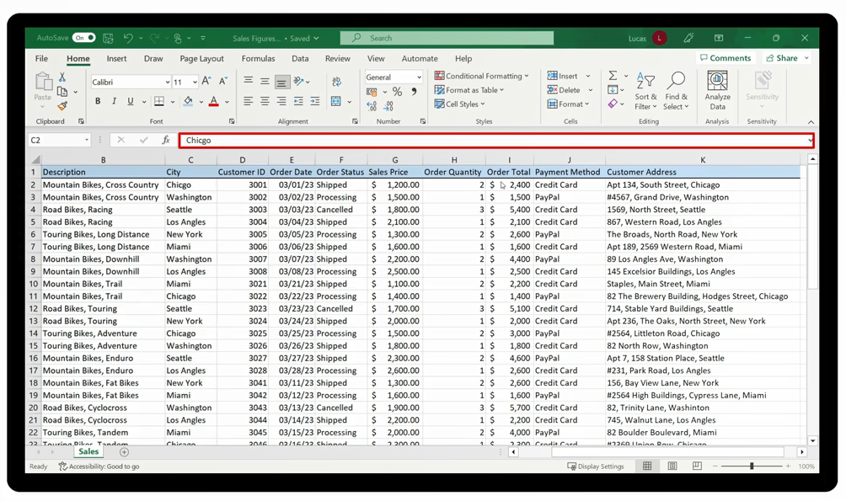

Slide 6

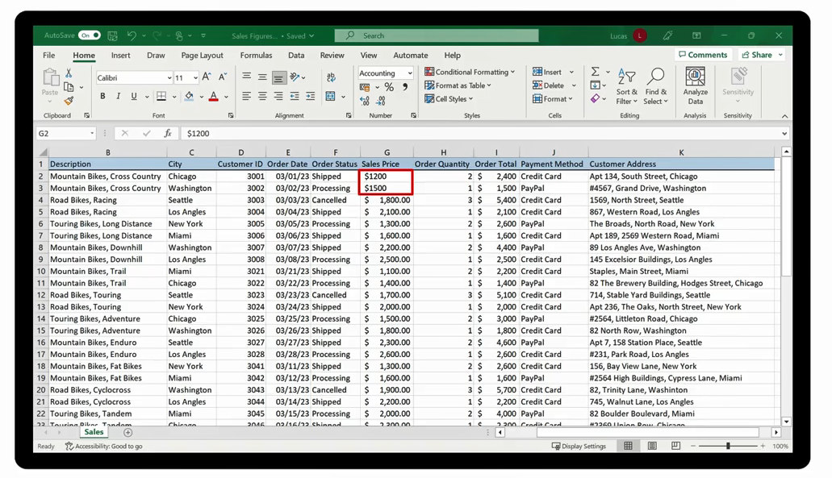

Slide 7

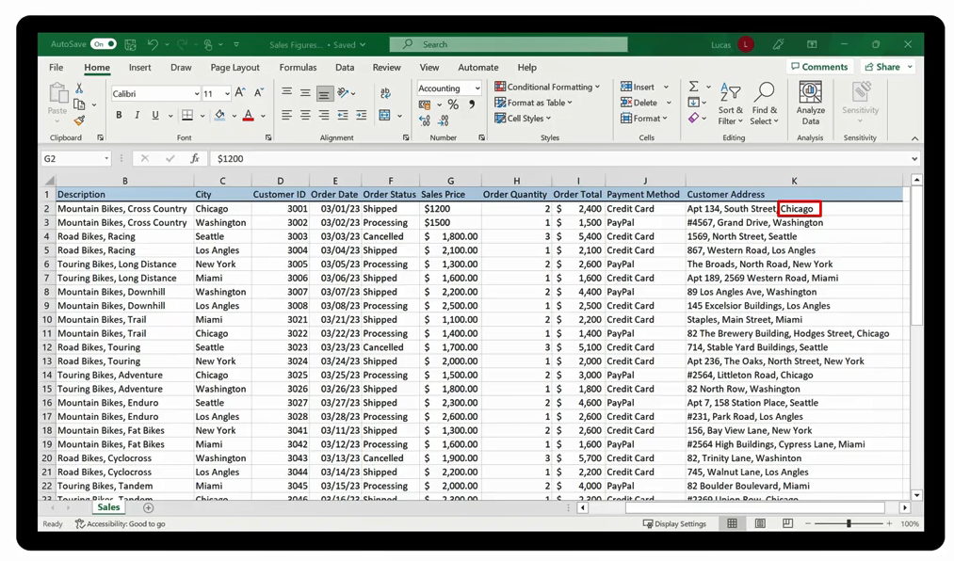

Slide 8

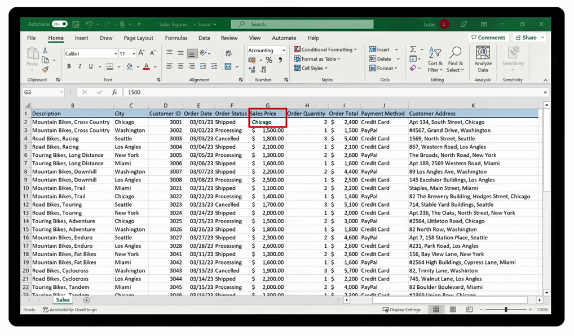

Slide 9
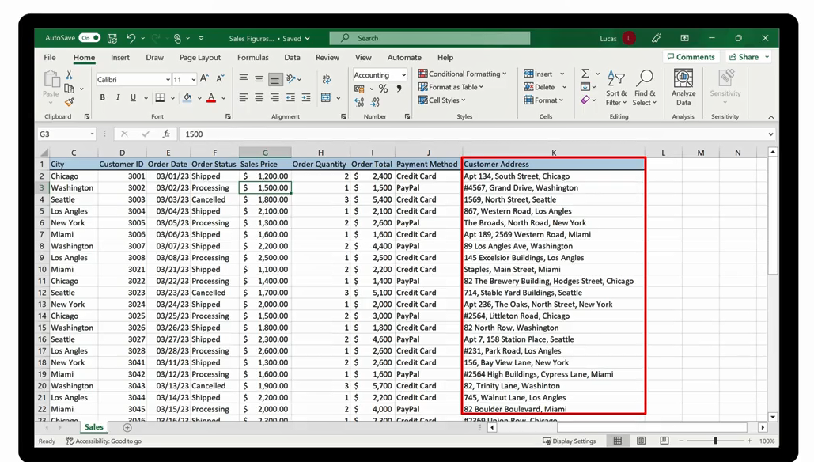


Slide 10
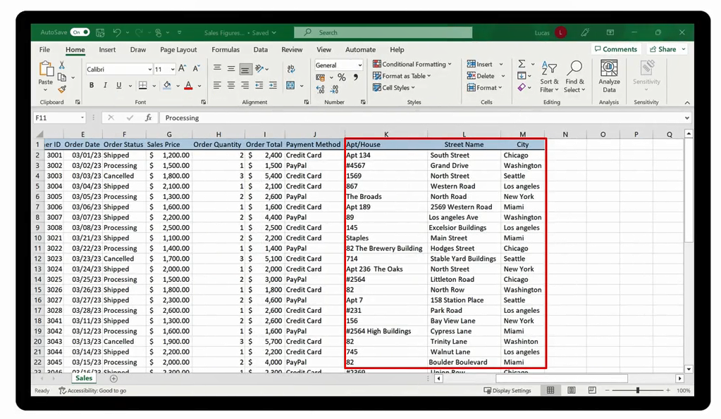

Slide 11
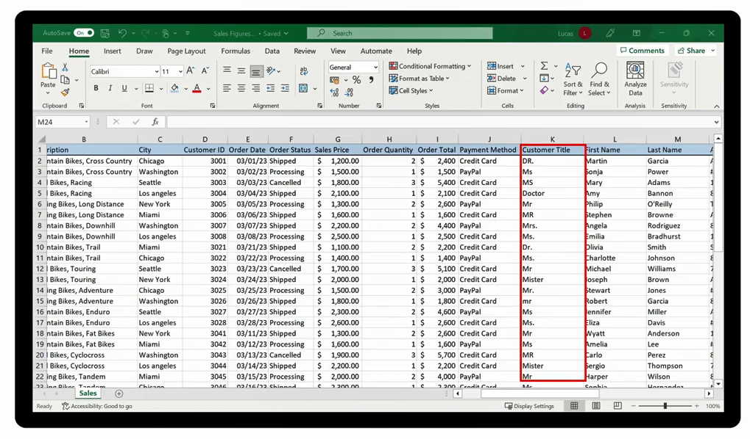


Slide 12
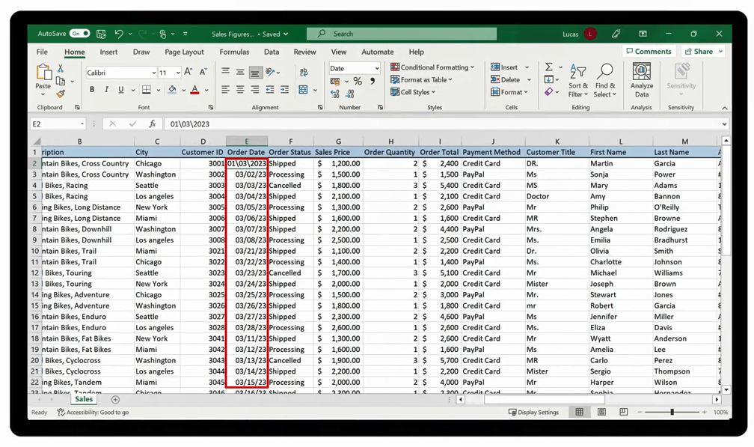


Slide 13



Slide 14
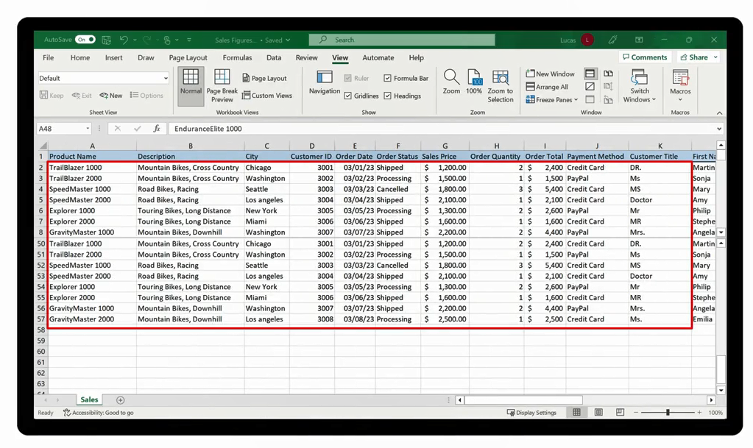

Slide 15
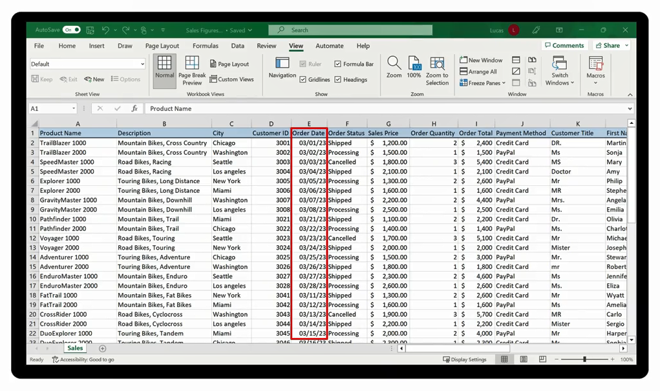
How to avoid?

Slide 16
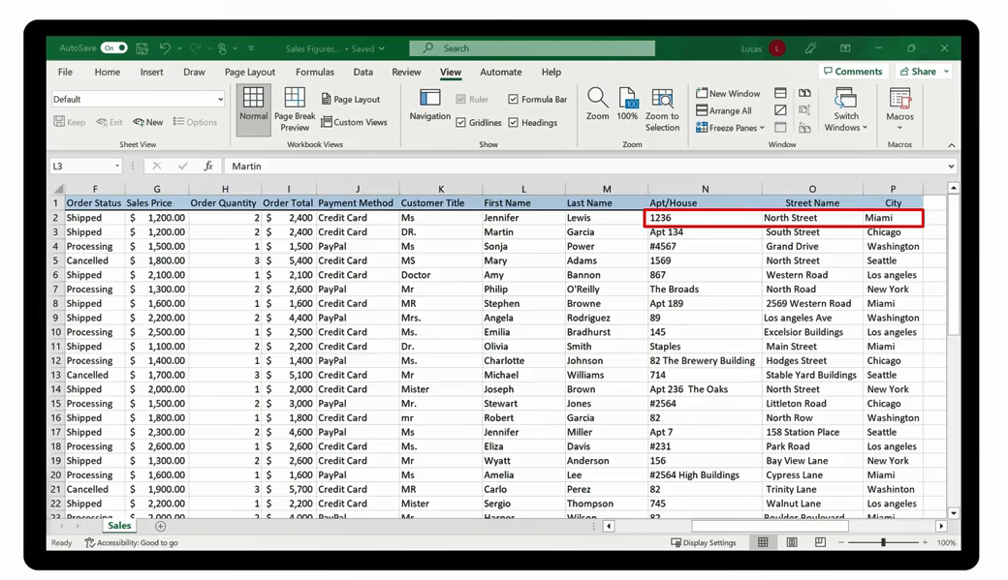
How to avoid?

Slide 17

Question 5-1
Jamie wants to perform a time analysis of Adventure Works’ sales data. However, a time analysis isn’t possible because of how the date is currently formatted. What error might have caused this formatting issue?
The dates are typed as text.
The dates are typed with forward slashes.
The dates are typed as numbers.

Slide 18

Question 5-1
Jamie wants to perform a time analysis of Adventure Works’ sales data. However, a time analysis isn’t possible because of how the date is currently formatted. What error might have caused this formatting issue?
The dates are typed as text.
The dates are typed with forward slashes.
The dates are typed as numbers.

Slide 19
Functions used to standardize text data
2

Slide 20
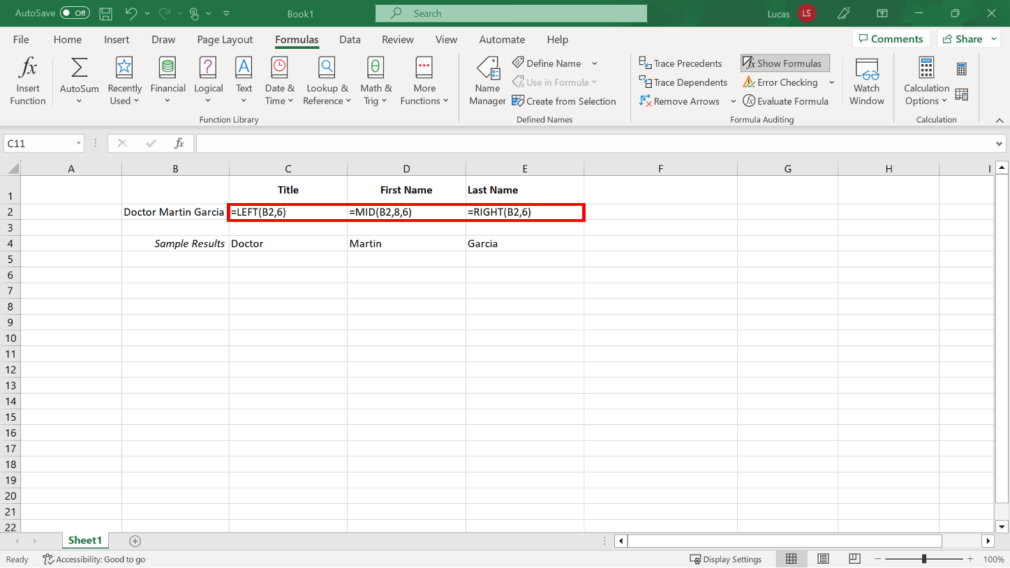
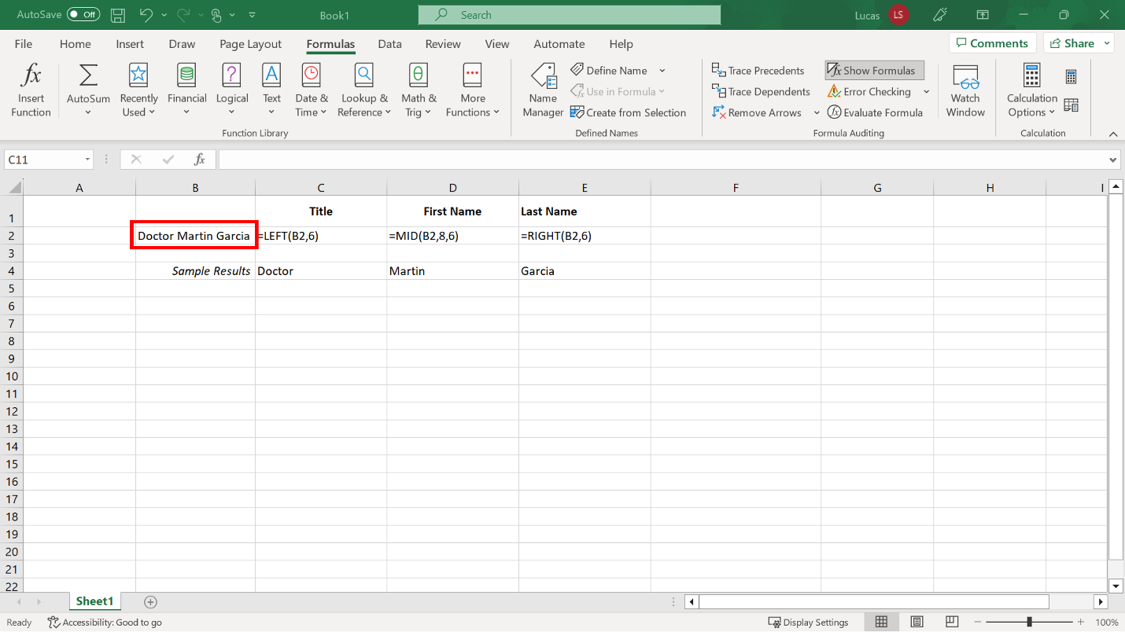
The LEFT, RIGHT and MID Functions

Slide 21
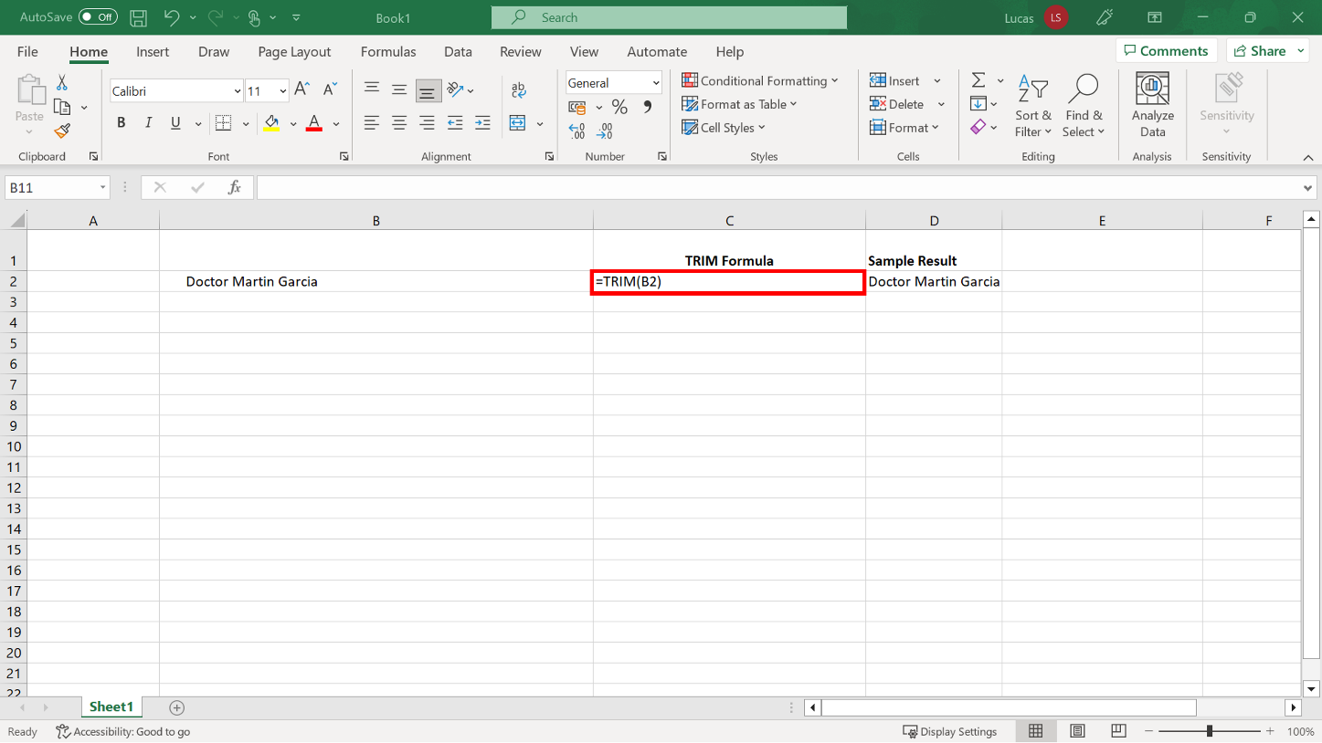
TRIM

Slide 22
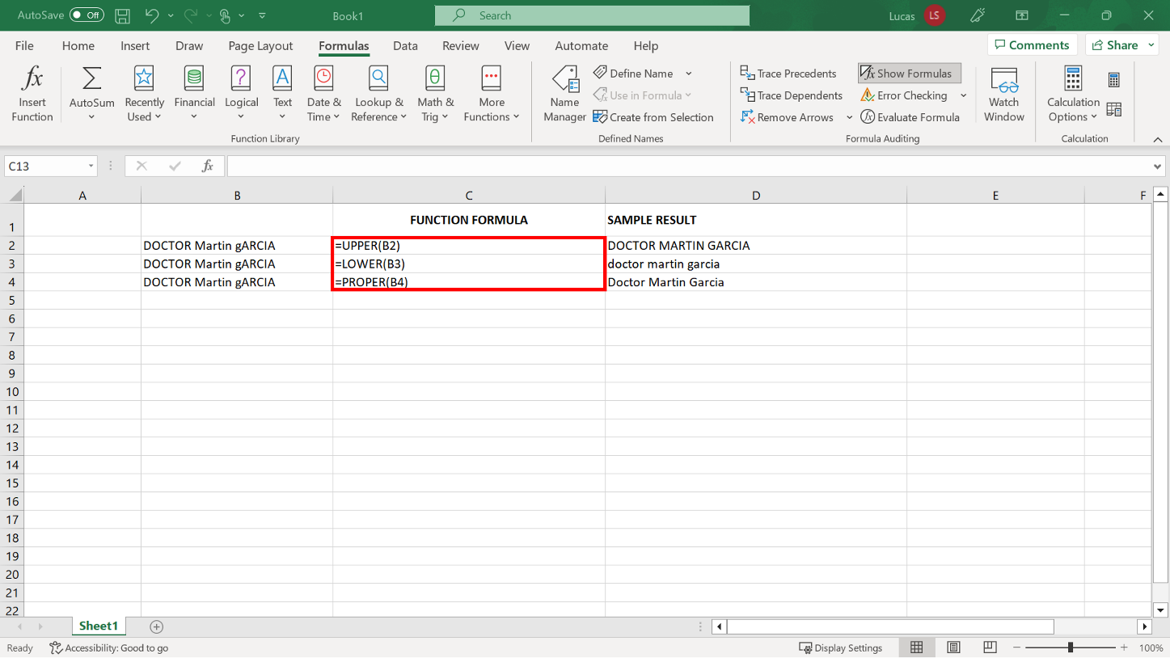
UPPER, LOWER and PROPER

Slide 23
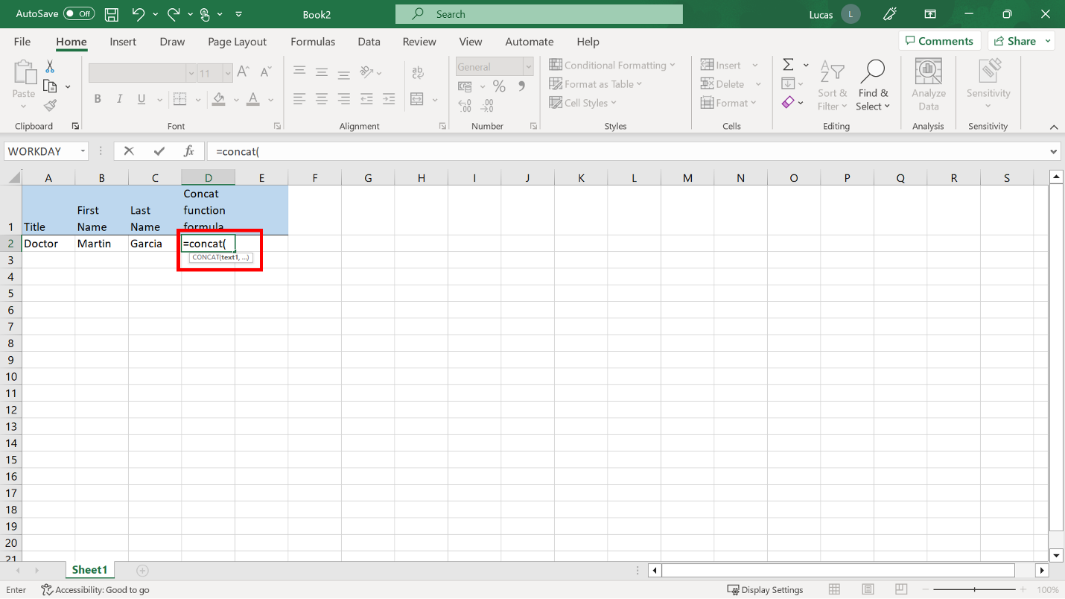
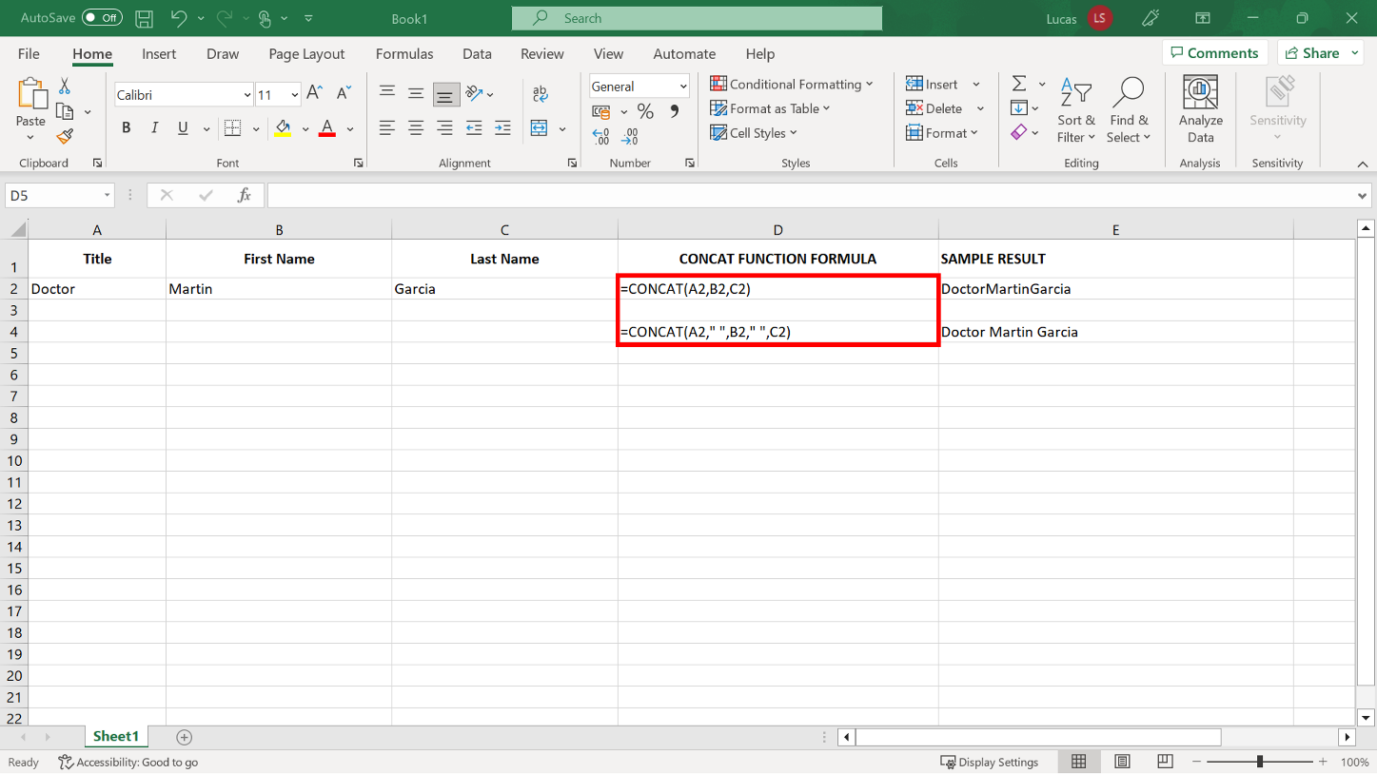
CONCAT

Slide 24

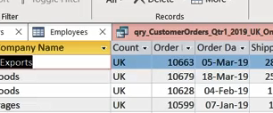
Exercise 5: Standardizing text-based data.

Slide 25

Exercise Questions
Question 1
In your worksheet, you created formulas in column C that included the TRIM function and cell references from column B as arguments. The entries in column B contained a lot of unnecessary spaces though the entries contain only a single space between each word. What did the formulas remove?
The spaces before and after the entries.
The spaces before the entries only.
The spaces before, after, and in the entries.

Slide 26
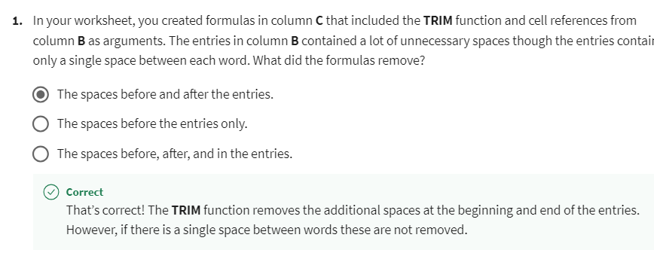
Exercise Questions
Explanation

Slide 27
Exercise Questions
Question 2
True or False: You created formulas in cells K2 to K200 to combine the content from column G and column l. You were then able to delete columns G and I immediately, as they were no longer required.
True
False

Slide 28
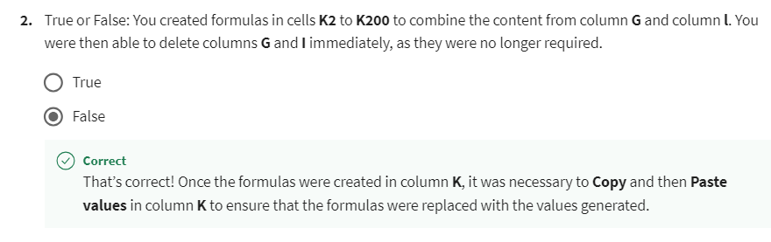
Exercise Questions
Explanation

Slide 29
Exercise Questions
Question 3
In the CONCAT formula in K2, you added a third argument to indicate that the two words needed space between them. What character did you input on either side of the space in the formula?
A parenthesis.
A double quote.
An exclamation mark.

Slide 30
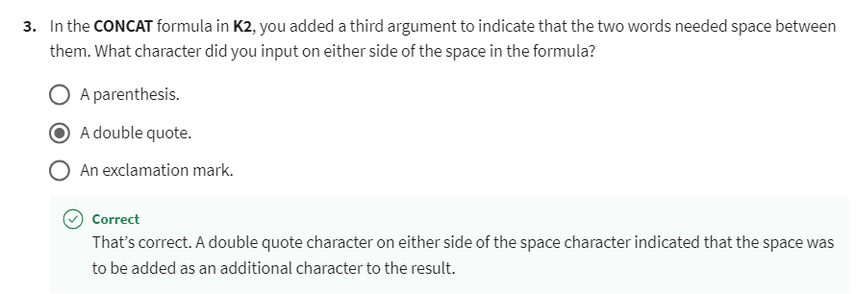
Exercise Questions
Explanation

Slide 31


Slide 32

5
Question 1
True or False: An Excel spreadsheet contains country names split over multiple columns. Cell A2 contains the word United. Cell B2 contains the word States. When executed, the following formula generates the result United States:
=CONCAT(A2," ",B2)
True
B. False

Slide 33
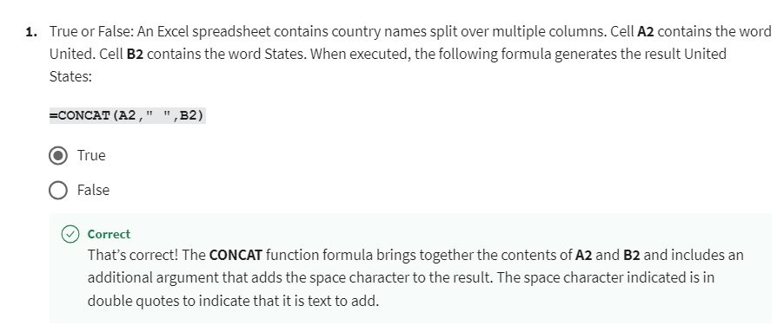
5
Explanation

Slide 34
5
Question 2
One of the employees at Adventure Works has made some typing errors in a spreadsheet. A text entry in cell contains the following text:
aDVENTURE wORKS rESELLERS
Which function should you use in a formula to copy this entry so that it is in lowercase with a capital letter at the beginning of each word?
LOWER
PROPER
UPPER

Slide 35
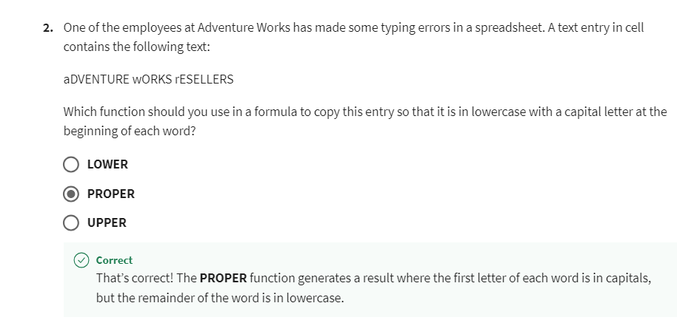
5
Explanation

Slide 36
5
Question 3
In the Adventure Works Reseller spreadsheet, the reseller names are listed in column D. Cell D2 contains the following text, which is left-aligned in the cell with no redundant spaces:
EastBike Shop
What is the result of this formula?
=MID(D2,5,4)
Bike
Shop
East

Slide 37
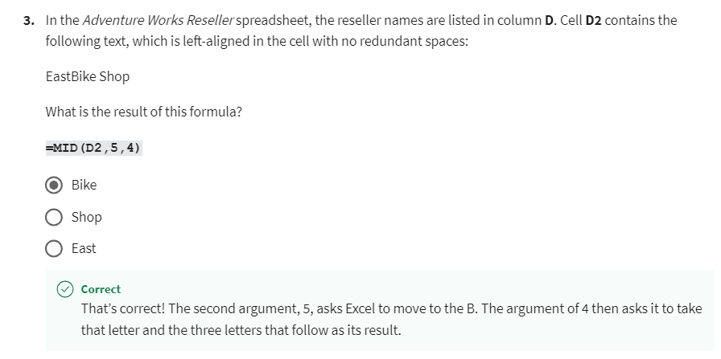
5
Explanation

Slide 38
5
Question 4
Cell A2 contains the following entry:
aceE6548.
What result would the following formula generate when applied to the above entry?
=UPPER(A2)
aCE6548
Ace6548.
ACEE6548

Slide 39
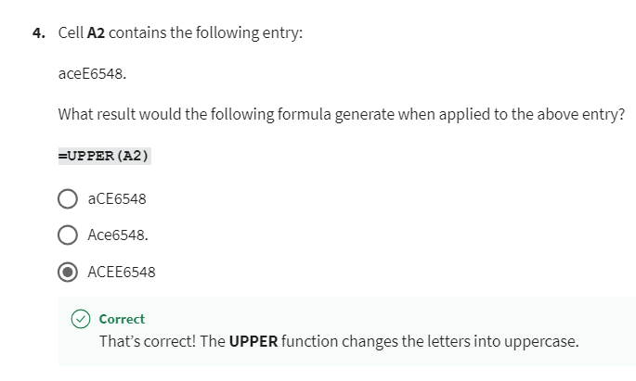
5
Explanation

Slide 40
5
Question 5
Cell E4 contains the city name North Miami Beach. What result would the following formula generate in your worksheet?
=RIGHT(E4,5)
North
Miami
Beach

Slide 41
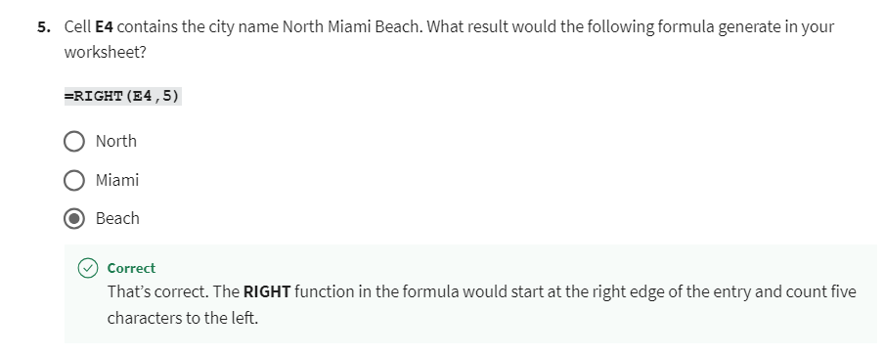
5
Explanation

Slide 42


